Slide 1

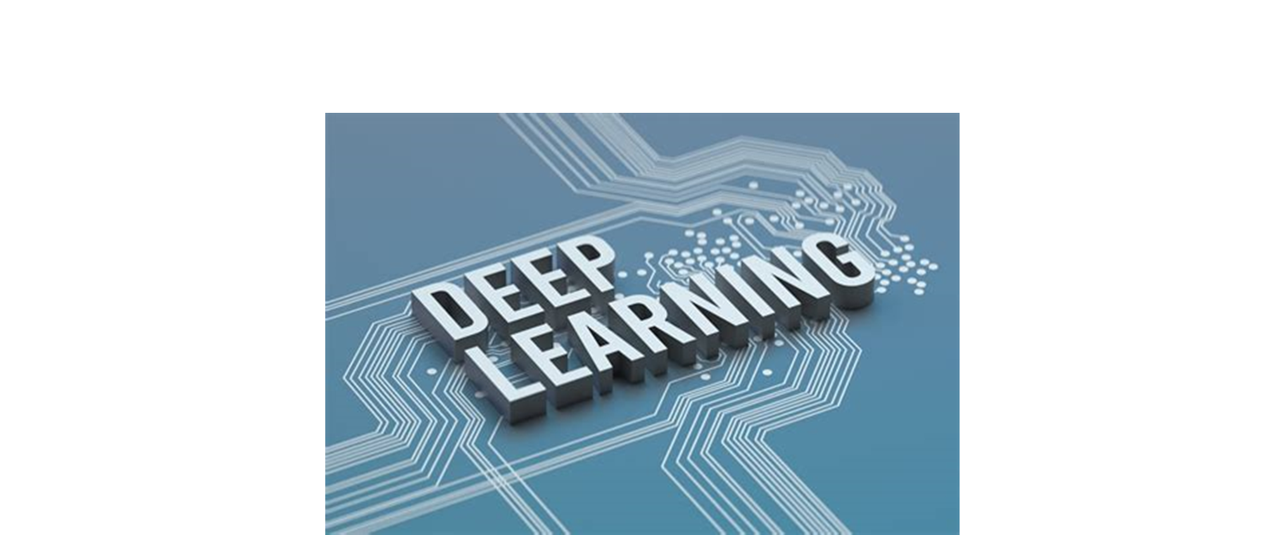
ASANSOL ENGINEERING COLLEGE
GROUP -19
(Roll No. - 73,74,75,76)

Slide 2
DEPARTMENT OF INFORMATION TECHNOLOGY
Sub- Machine Learning(PEC-IT701D)
(Topic – Deep Learning)
Anurag Ghosh - 10800219073
Aishwarya Ghosh - 10800219074
Jyoti Mondal - 10800219075
Arati Sonar - 10800219076

Slide 3
CONTENTS
CONTENTS | PAGE NO
What is Deep Learning | 4
Examples of Deep Learning | 5
How Deep Learning Works | 6
Types of Deep Learning | 7
Deep learning applications | 8
Deep learning hardware requirements | 9 – 11
Advantages and Disadvantages | 12

Slide 4
What is Deep Learning?
Deep learning is a subset of machine learning, which is essentially a neural network with three or more layers. These neural networks attempt to simulate the behavior of the human brain- albeit far from matching its ability—allowing it to “learn” from large amounts of data.
Deep learning drives many Artificial Intelligence(AI) applications and services that improve automation, performing analytical and physical tasks without human intervention. Deep learning technology lies behind everyday products and services (such as digital assistants, voice-enabled TV remotes, and credit card fraud detection) as well as emerging technologies (such as self-driving cars).

Slide 5
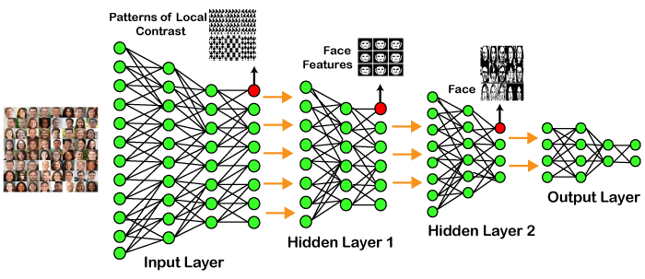
Examples of Deep Learning:

Slide 6
How Deep Learning Works?
Deep learning neural networks, or artificial neural networks, attempts to mimic the human brain through a combination of data inputs, weights, and bias. These elements work together to accurately recognize, classify, and describe objects within the data.
Deep neural networks consist of multiple layers of interconnected nodes, each building upon the previous layer to refine and optimize the prediction or categorization.
This progression of computations through the network is called forward propagation. The input and output layers of a deep neural network are called visible layers.

Slide 7
Types of Deep Learning:
Feed Forward Neural Network
Recurrent Neural Network
Convolutional Neural Network
Restricted Boltzmann Machine
Autoencoders

Slide 8
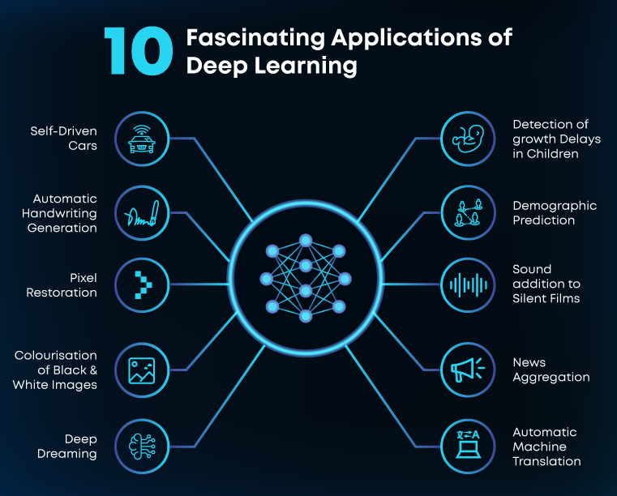
Deep learning applications:-

Slide 9
Deep learning hardware requirements:
Deep learning requires a tremendous amount of computing power. High performance Graphical Processing Units (GPUs)are ideal because they can handle a large volume of calculations in multiple cores with copious memory available. However, managing multiple GPUs on-premises can create a large demand on internal resources and be incredibly costly to scale.
There are few fundamental operation of Deep Learning:
Deep Learning algorithms today consists mostly of Convolutional Neural Networks (CNNs) and Recurrent Neural Networks (RNNs).

Slide 10
Matrix Multiplication – This exists in almost all models of Deep Learning and is computationally intensive.
Convolution – This is yet another commonly used operation and takes up most of the flops (Floating point operations per second) in the model.
Recurrent Layers – These are feedback layers within the model and is essentially a combination of the previous two operations.
All Reduce – This is a basically a sequence of operations to communicate or parse the learned parameters before optimization. This is specifically useful when performing synchronous optimization over a Deep Learning Network that is distributed across multiple hardware (as in the case of AlphaGo).

Slide 11
Hardware accelerators for deep learning
Apart from these, hardware accelerators for Deep Learning require features like Data level and pipelined parallelism, multithreading, and high memory bandwidth.
Current trends and Future scope
NVIDIA has been dominating the current Deep Learning market with its massively parallel. Companies like Teradeep are now starting to use FPGAs (Field-Programmable Gate Arrays) as they could be up to 10 times more power efficient than GPUs. FPGAs are more flexible , scalable and provide better Performance per Watt than GPUs

Slide 12
Advantages:-
It lessens the need for feature engineering.
It eradicates all those costs that are needless.
It easily identifies difficult defects.
It results in the best-in-class performance on problems.
Disadvantages:
It requires an ample amount of data.
It is quite expensive to train.
It does not have strong theoretical groundwork.

Slide 13
THANK YOU

